Slide 1
SOLVING PROBLEMS BY SEARCHING
Philip Apodo Oyier
oyier@itc.jkuat.ac.ke

Slide 2
Problem Solving
We want:
  To automatically solve a problem
We need:
  A representation of the problem
  Algorithms that use some strategy to solve the problem defined in that representation

Slide 3
Problem Solving Contd.
Problems generally represented as graphs
Problem solving ~ searching a graph
Two representations
(1) State space (usual graph)
(2) AND/OR graph

Slide 4
Problem Representation
General:
  State space: a problem is divided into a set of resolution steps from the initial state to the goal state
  Reduction to sub-problems: a problem is arranged into a hierarchy of sub-problems
Specific:
  Game resolution
  Constraints satisfaction

Slide 5
States
A problem is defined by its elements and their relations.
In each instant of the resolution of a problem, those elements have specific descriptors (How to select them?) and relations.
A state is a representation of those elements in a given moment.
Two special states are defined:
  Initial state (starting point)
  Final state (goal state)

Slide 6
State Modification: Successor Function
A successor function is needed to move between different states.
A successor function is a description of possible actions, a set of operators. It is a transformation function on a state representation, which convert it into another state.
The successor function defines a relation of accessibility among states.
Representation of the successor function:
  Conditions of applicability
  Transformation function

Slide 7
State Space
The state space is the set of all states reachable from the initial state.
It forms a graph (or map) in which the nodes are states and the arcs between nodes are actions.
A path in the state space is a sequence of states connected by a sequence of actions.
The solution of the problem is part of the map formed by the state space.

Slide 8
State Space Contd.
State space = Directed graph
Nodes ~ Problem situations
Arcs ~ Actions, legal moves
Problem = ( State space, Start, Goal condition)
Note: several nodes may satisfy goal condition
Solving a problem ~ Finding a path
Problem solving ~ Graph search
Problem solution ~ Path from start to a goal node

Slide 9
Problem Solution
A solution in the state space is a path from the initial state to a goal state or, sometimes, just a goal state.
Path/solution cost: function that assigns a numeric cost to each path, the cost of applying the operators to the states
Solution quality is measured by the path cost function, and an optimal solution has the lowest path cost among all solutions.
Solutions: any, an optimal one, all.
Cost is important depending on the problem and the type of solution sought.

Slide 10
Problem Description
Components:
  State space (explicitly or implicitly defined)
  Initial state
  Goal state (or the conditions it has to fulfill)
  Available actions (operators to change state)
  Restrictions (e.g., cost)
  Elements of the domain which are relevant to the problem (e.g., incomplete knowledge of the starting point)
  Type of solution:
    Sequence of operators or goal state
    Any, an optimal one (cost definition needed), all

Slide 11
Examples of Representing Problems in State Space
Blocks world planning
8-puzzle, 15-puzzle
8 queens
Travelling salesman
Set covering
How can these problems be represented by graphs?
Propose corresponding state spaces

Slide 12
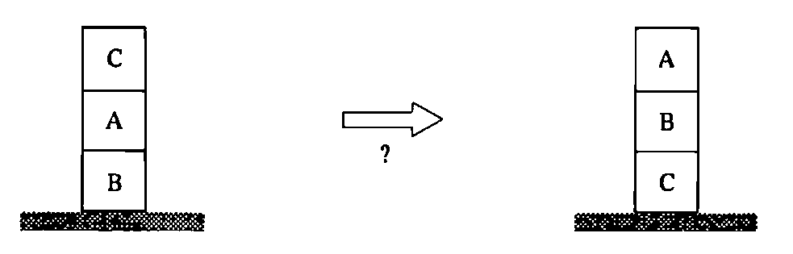
Example 1: A problem from blocks world
Find a sequence of robot moves to re-arrange blocks

Slide 13
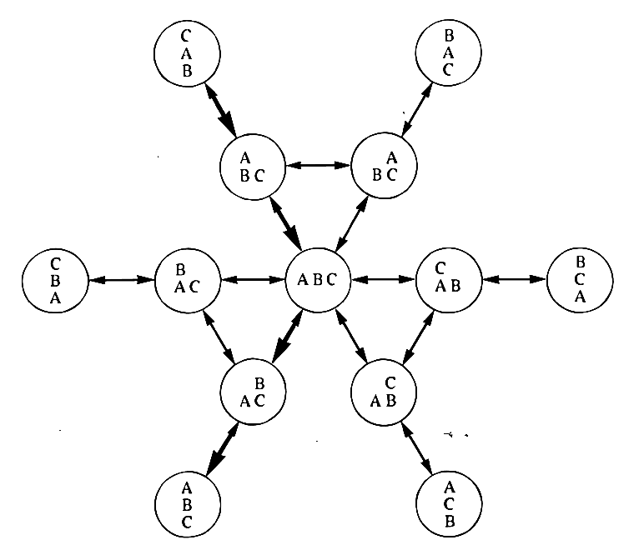
Blocks World state space

Slide 14
Example 2: 8-puzzle
1
2
3
4
5
6
7
8

Slide 15
Example 2: 8-puzzle
State space: configuration of the eight tiles on the board
Initial state: any configuration
Goal state: tiles in a specific order
Operators or actions: “blank moves”
  Condition: the move is within the board
  Transformation: blank moves Left, Right, Up, or Down
Solution: optimal sequence of operators

Slide 16
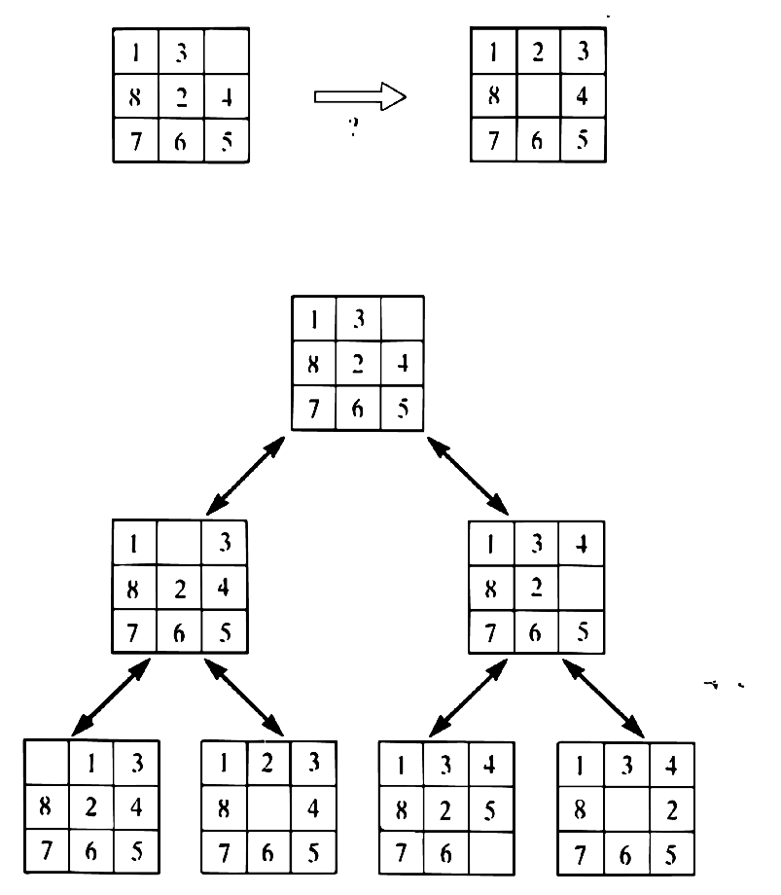
8-puzzle

Slide 17
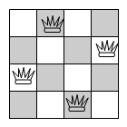
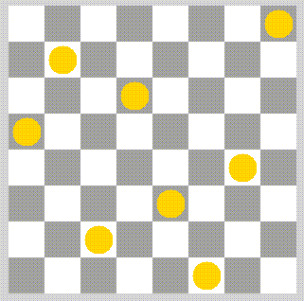
Example 3: n queens
(n = 4, n = 8)

Slide 18
Example: n queens
(n = 4, n = 8)
State space: configurations from 0 to n queens on the board with only one queen per row and column
Initial state: configuration without queens on the board
Goal state: configuration with n queens such that no queen attacks any other
Operators or actions: place a queen on the board
  Condition: the new queen is not attacked by any other already placed
  Transformation: place a new queen in a particular square of the board
Solution: one solution (cost is not considered)

Slide 19
State spaces for optimisation problems
Optimisation: minimise cost of solution
In blocks world:
actions may have different costs
(blocks have different weights, ...)
Assign costs to arcs
Cost of solution = cost of solution path

Slide 20
More complex examples
Making a time table
Production scheduling
Grammatical parsing
Interpretation of sensory data
Modelling from measured data
Finding scientific theories that account for experimental data

Slide 21
Structure of the state space
Data structures:
  Trees: only one path to a given node
  Graphs: several paths to a given node
Operators: directed arcs between nodes
The search process explores the state space.
In the worst case all possible paths between the initial state and the goal state are explored.

Slide 22
Search as goal satisfaction
Satisfying a goal
  Agent knows what the goal is
  Agent cannot evaluate intermediate solutions (uninformed)
  The environment is:
    Static
    Observable
    Deterministic

Slide 23
Example: holiday in Romania
On holiday in Romania; currently in Arad
Flight leaves tomorrow from Bucharest at 13:00
Let’s configure this to be an AI problem

Slide 24
Romania
What’s the problem?
  Accomplish a goal
    Reach Bucharest by 13:00
So this is a goal-based problem

Slide 25
Romania
What’s an example of a non-goal-based problem?
  Live long and prosper
  Maximize the happiness of your trip to Romania
  Don’t get hurt too much

Slide 26
Romania
What qualifies as a solution?
  You can/cannot reach Bucharest by 13:00
  The actions one takes to travel from Arad to Bucharest along the shortest (in time) path

Slide 27
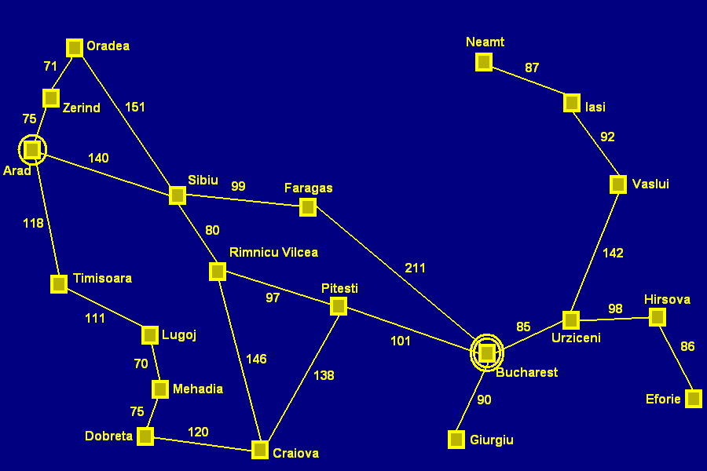
Romania
What additional information does one need?
  A map

Slide 28
More concrete problem definition
A state space
Which cities could you be in?
An initial state
Which city do you start from?
A goal state
Which city do you aim to reach?
A function defining state transitions
When in city foo, the following cities can be reached
A function defining the “cost” of a state sequence
How long does it take to travel through a city sequence?

Slide 29
More concrete problem definition
A state space
Choose a representation
An initial state
Choose an element from the representation
A goal state
Create goal_function(state) such that TRUE is returned upon reaching goal
A function defining state transitions
successor_function(state_{i}) =
{<action_{a}, state_{a}>, <action_{b}, state_{b}>, …}
A function defining the “cost” of a state sequence
cost (sequence) = number

Slide 30
Important notes about this example
  Static environment (available states, successor function, and cost functions don’t change)
  Observable (the agent knows where it is)
  Discrete (the actions are discrete)
  Deterministic (successor function is always the same)

Slide 31
Tree search algorithms
Basic idea:
  Simulated exploration of state space by generating successors of already explored states (AKA expanding states)
Sweep out from start (breadth)

Slide 32
Tree search algorithms
Basic idea:
  Simulated exploration of state space by generating successors of already explored states (AKA expanding states)
Go East, young man! (depth)

Slide 33
Implementation: general search algorithm
Algorithm General Search
Open_states.insert (Initial_state)
Current= Open_states.first()
while not is_final?(Current) and not Open_states.empty?() do
Open_states.delete_first()
Closed_states.insert(Current)
Successors= generate_successors(Current)
Successors= process_repeated(Successors, Closed_states, Open_states)
Open_states.insert(Successors)
Current= Open_states.first()
eWhile
eAlgorithm

Slide 34
Example: Arad → Bucharest
Algorithm General Search
Open_states.insert (Initial_state)
Arad

Slide 35
Example: Arad → Bucharest
Current= Open_states.first()
Arad

Slide 36
Example: Arad → Bucharest
while not is_final?(Current) and not Open_states.empty?() do
Open_states.delete_first()
Closed_states.insert(Current)
Successors= generate_successors(Current)
Successors= process_repeated(Successors, Closed_states, Open_states)
Open_states.insert(Successors)
Arad
Zerind (75)
Timisoara (118)
Sibiu (140)

Slide 37
Example: Arad → Bucharest
Current= Open_states.first()
Arad
Zerind (75)
Timisoara (118)
Sibiu (140)

Slide 38
Example: Arad → Bucharest
while not is_final?(Current) and not Open_states.empty?() do
Open_states.delete_first()
Closed_states.insert(Current)
Successors= generate_successors(Current)
Successors= process_repeated(Successors, Closed_states,Open_states)
Open_states.insert(Successors)
Arad
Zerind (75)
Timisoara (118)
Sibiu (140)
Dradea (151)
Faragas (99)
Rimnicu Vilcea (80)

Slide 39
Implementation: states vs. nodes
State
  (Representation of) a physical configuration
Node
  Data structure constituting part of a search tree
    Includes parent, children, depth, path cost g(x)
States do not have parents, children, depth, or path cost!

Slide 40
Search strategies
A strategy is defined by picking the order of node expansion
Strategies are evaluated along the following dimensions:
  Completeness – does it always find a solution if one exists?
  Time complexity – number of nodes generated/expanded
  Space complexity – maximum nodes in memory
  Optimality – does it always find a least-cost solution?

Slide 41
Search strategies
Time and space complexity are measured in terms of:
  b – maximum branching factor of the search tree (may be infinite)
  d – depth of the least-cost solution
  m – maximum depth of the state space (may be infinite)

Slide 42
SEARCH METHODS
Uninformed techniques:
systematically search complete graph, unguided
Informed methods:
Use problem specific information to guide search in promising directions
What is “promising”?
Domain specific knowledge
Heuristics

Slide 43
Uninformed Search Strategies
Uninformed strategies use only the information available in the problem definition
  Breadth-first search
  Uniform-cost search
  Depth-first search
  Depth-limited search
  Iterative deepening search

Slide 44
Informed, heuristic search
Best-first search
Hill climbing, steepest descent
Algorithm A*
Beam search
Algorithm IDA* (Iterative Deepening A*)
Algorithm RBFS (Recursive Best First Search)

Slide 45
Direction of search
Forward search: from start to goal
Backward search: from goal to start
Bidirectional search
In expert systems:
Forward chaining
Backward chaining

Slide 46
Nodes
Open nodes:
  Generated, but not yet explored
  Explored, but not yet expanded
Closed nodes:
  Explored and expanded

Slide 47
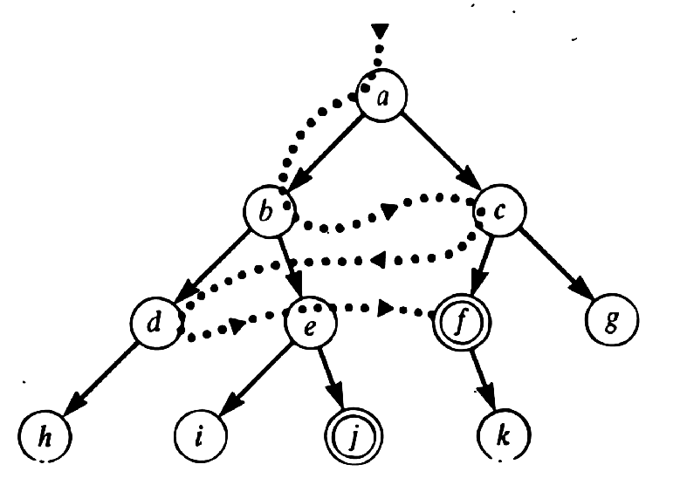
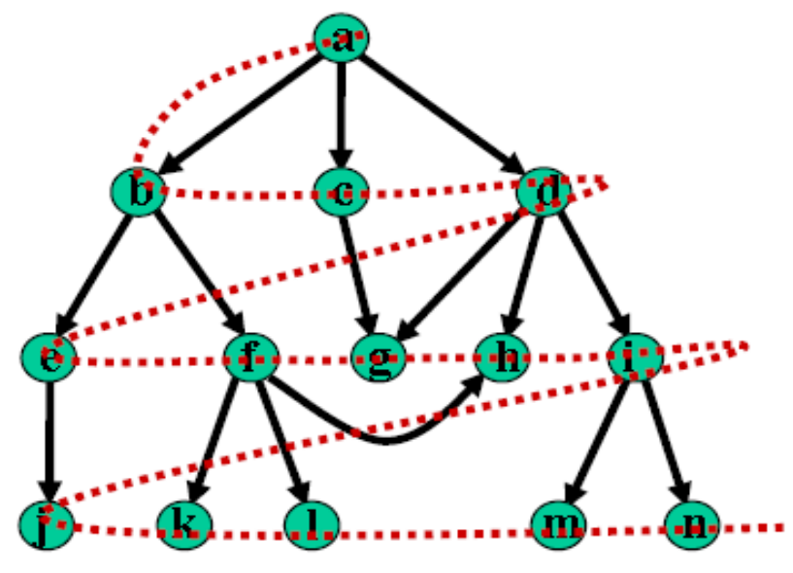
Breadth-first Search
In this method, After visiting a vertex v, we must visit all its adjacent vertices w1, w2, w3, ..., before going down to the next level to visit vertices adjacent to w1 etc. i.e expand shallowest unexpanded node
Guaranteed to find shortest solution first
Implementation:
  A FIFO queue, i.e., new successors go at end

Slide 48
A Breadth-first Search Program
Breadth-first search completes one level before moving on to next level
Has to keep in memory all the competing paths that aspire to be extended to a goal node
A possible representation of candidate paths: list of lists
Easiest to store paths in reverse order;
then, to extend a path, add a node as new head (easier than adding a node at end of list)

Slide 49
Breadth-First Traversal Algorithm Using a Queue
A boolean array is used to ensure that a vertex is enqueued only once.
    enqueue the starting vertex
    while(queue is not empty){
    dequeue a vertex v from the queue;
    visit v.
    enqueue vertices adjacent to v that were never enqueued;
    }
Note: Adjacent vertices can be enqueued in any order; but to obtain a unique traversal, we will enqueue them in alphabetical order.

Slide 50
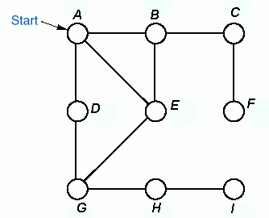

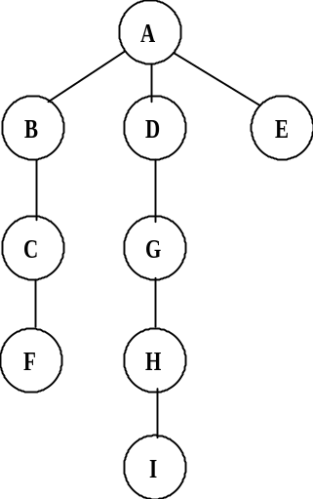

Example: Breadth-first Traversal using a Queue
Queue front
BFS-tree:
Order of
Traversal
A B D E C G F H I
Queue rear

Slide 51
Breadth-First Traversal Implementation
public void breadthFirstTraversal(Visitor visitor, Vertex start){
boolean enqueued[] = new boolean[numberOfVertices];
for(int i = 0; i < numberOfVertices; i++) enqueued[i] = false;
Queue queue = new QueueAsLinkedList();
enqueued[getIndex(start)] = true;
queue.enqueue(start);
while(!queue.isEmpty() && !visitor.isDone()) {
Vertex v = (Vertex) queue.dequeue();
visitor.visit(v);
Iterator it = v.getSuccessors();
while(it.hasNext()) {
Vertex to = (Vertex) it.next();
int index = getIndex(to);
if(!enqueued[index]) {
enqueued[index] = true;
queue.enqueue(to);
} } } }

Slide 52
Space cost of BFS
Because you must be able to generate the path upon finding the goal state, all visited nodes must be stored
O (b^{d+1})

Slide 53
Properties of breadth-first search
Complete?
  Yes (if b (max branch factor) is finite)
Time?
  1 + b + b² + … + b^{d} + b(b^{d}-1) = O(b^{d+1}), i.e., exponential in d
Space?
  O(b^{d+1}) (keeps every node in memory)
Optimal?
  Only if cost = 1 per step, otherwise not optimal in general
Space is the big problem; it can easily generate nodes at 10 MB/s, so 24 hrs = 860GB!

Slide 54
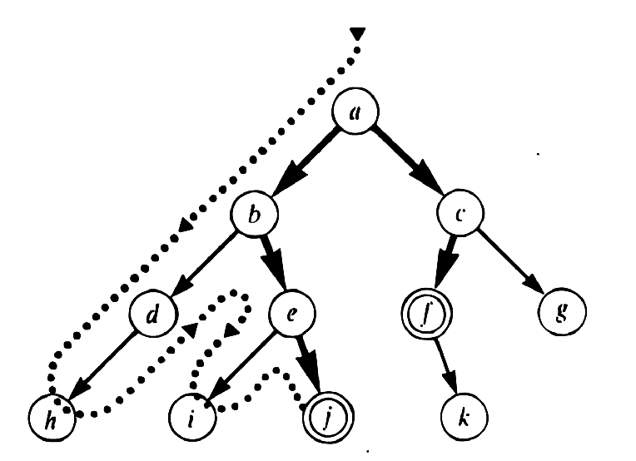
Depth-first search
A DFS starting at a vertex v first visits v, then some neighbor w of v, then some neighbor x of w that has not been visited before, etc.
When it gets stuck, the DFS backtracks until it finds the first vertex that still has a neighbor that has not been visited before.
It continues with this neighbor until it has to backtrack again. Eventually, it will visit all vertices reachable from v
Expand deepest unexpanded node
Implementation:
  A LIFO queue, i.e., a stack

Slide 55
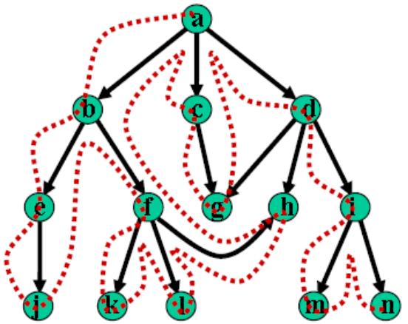
Depth-first Search Contd.
Must keep track of vertices already visited to avoid cycles.
The method can be implemented using recursion or iteration.
The iterative preorder depth-first algorithm is:
  push the starting vertex onto the stack
  while(stack is not empty){
  pop a vertex off the stack, call it v
  if v is not already visited, visit it
  push vertices adjacent to v, not visited, onto the stack
  }
Note: Adjacent vertices can be pushed in any order; but to obtain a unique traversal, we will push them in reverse alphabetical order.

Slide 56
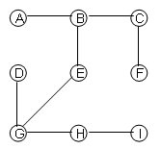
Example: Depth-first traversal using a Stack
The Preorder Depth First Tree:
Order of
Traversal
A B C F E G D H I
Stack
  ff

Slide 57
Recursive preorder Depth-First Traversal Implementation
    dfsPreorder(v){
    visit v;
    for(each neighbour w of v)
    if(w has not been visited)
    dfsPreorder(w);
    }

Slide 58
Properties of Depth-first search program
Is not guaranteed to find shortest solution first
Susceptible to infinite loops (should check for cycles)
Has low space complexity: only proportional to depth of search
Only requires memory to store the current path from start to the current node
When moving to alternative path, previously searched paths can be forgotten

Slide 59
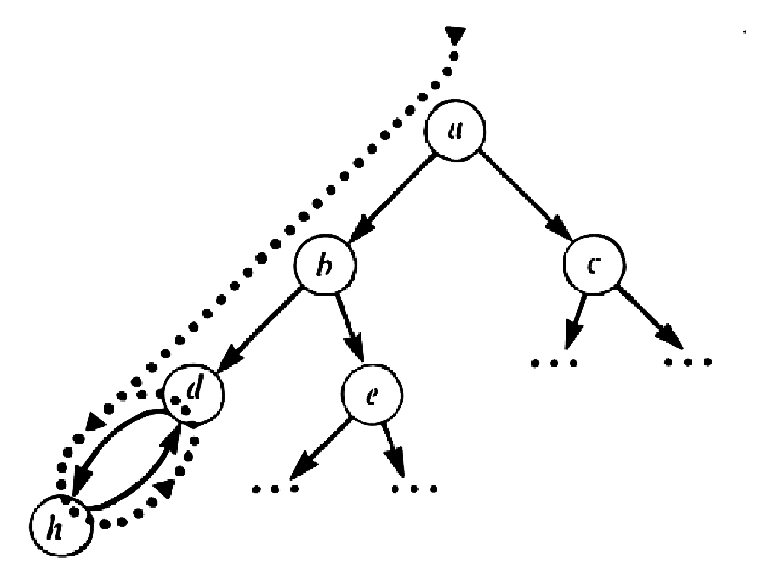
Depth-first search, problem of looping

Slide 60
Depth-first search
Complete?
    No: fails in infinite-depth spaces, spaces with loops.
    Can be modified to avoid repeated states along path ➔ complete in finite spaces
Time?
    O(b^{m}): terrible if m is much larger than d, but if solutions are dense, may be much faster than breadth-first
Space?
    O(bm), i.e., linear space!
Optimal?
    No

Slide 61
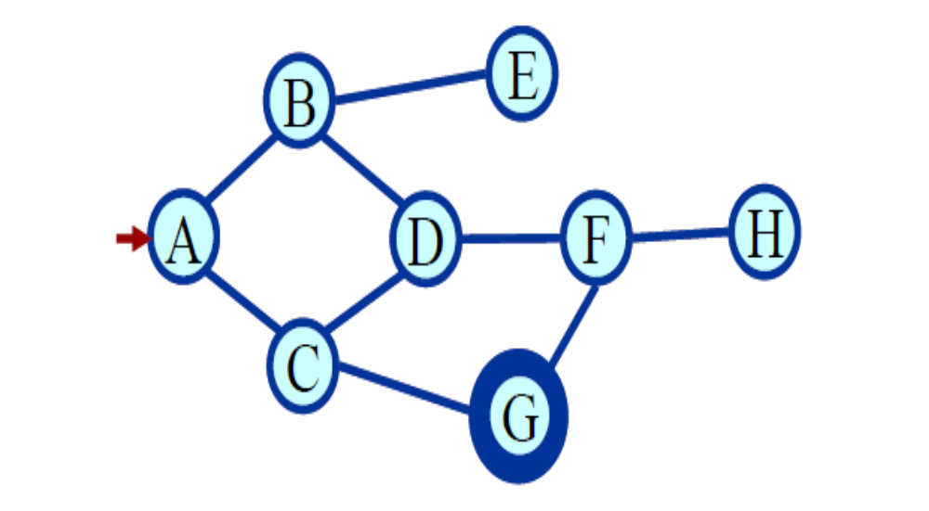
Example 1

Slide 62
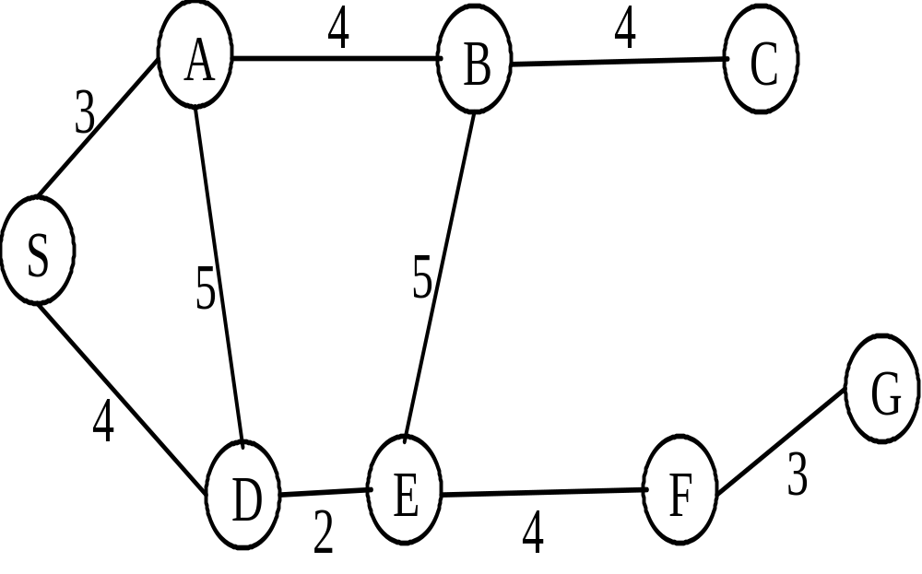
Example 2

Slide 63
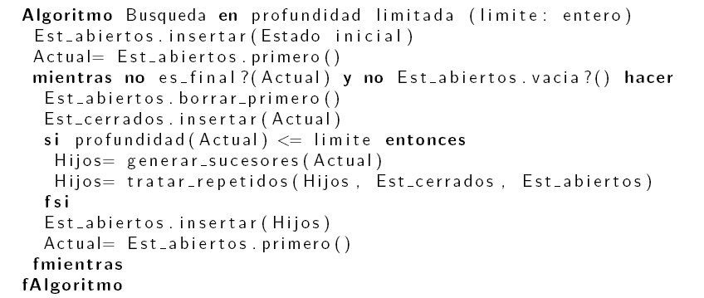
Depth-limited search
It is depth-first search with an imposed limit on the depth of exploration, to guarantee that the algorithm ends.

Slide 64
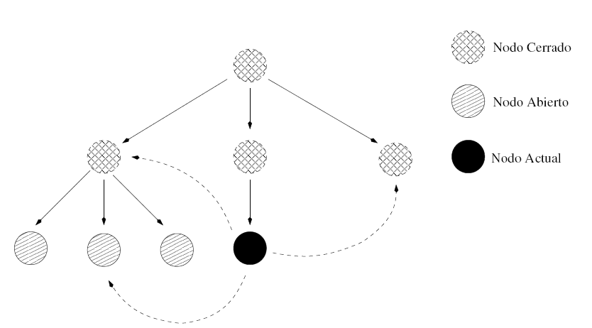
Treatment of repeated states
Breadth-first:
  If the repeated state is in the structure of closed or open nodes, the actual path has equal or greater depth than the repeated state and can be forgotten.

Slide 65
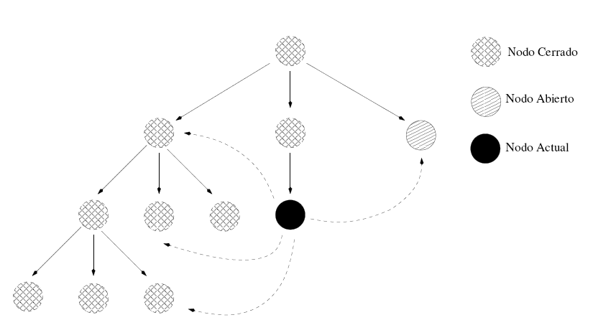
Treatment of repeated states
Depth-first:
  If the repeated state is in the structure of closed nodes, the actual path is kept if its depth is less than the repeated state.
  If the repeated state is in the structure of open nodes, the actual path has always greater depth than the repeated state and can be forgotten.

Slide 66
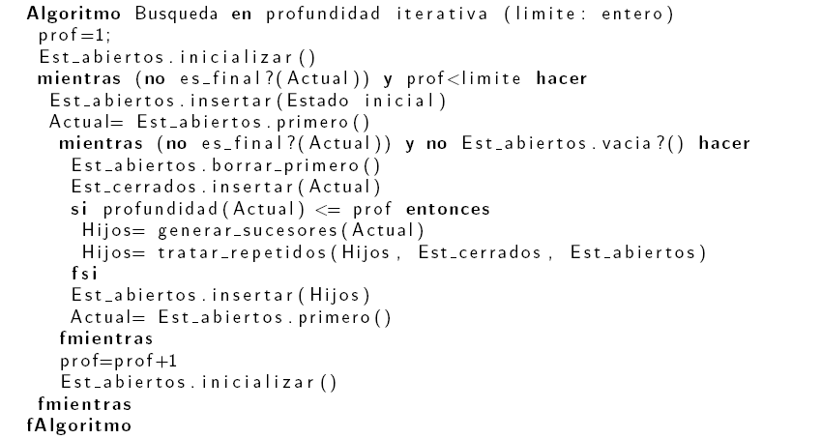
Iterative deepening search

Slide 67
Iterative deepening search
The algorithm consists of iterative, depth-first searches, with a maximum depth that increases at each iteration. Maximum depth at the beginning is 1.
Behavior similar to BFS, but without the spatial complexity.
Only the actual path is kept in memory; nodes are regenerated at each iteration.
DFS problems related to infinite branches are avoided.
To guarantee that the algorithm ends if there is no solution, a general maximum depth of exploration can be defined.

Slide 68
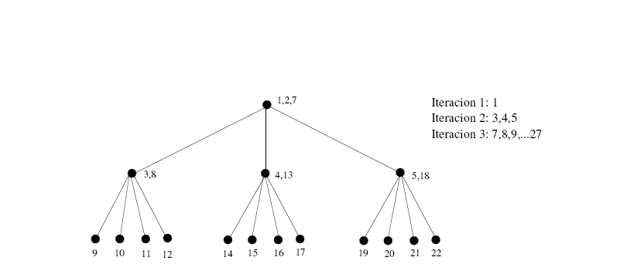
Iterative deepening search

Slide 69
Time and space complexity
Breadth-first and iterative deepening guarantee shortest solution
Breadth-first: high space complexity
Depth-first: low space complexity, but may search well below solution depth
Iterative deepening: best performance in terms of orders of complexity

Slide 70
Uniform-Cost Search
One simple way to sort the agenda is by the cost-so-far. This might be the number of moves we've made so far in a game, or the distance we've travelled so far looking for a route between towns.
If we sort the agenda so that the states with the lowest costs come first, then we'll always expand these first, and that means that we're sure we'll always find an optimal solution first.
This is uniform-cost search. It looks a lot like breadth-first search, except that it will find an optimal solution even if the steps between states have different costs (e.g. the distance between towns is irregular).
However, uniform-cost search doesn't really direct us towards the goal we're looking for, so it isn't very informed.

Slide 71
Uniform-Cost Search Contd.
g(n) = lowest path-cost from start node to node n
Frontier: priority queue ordered by g(n)
Expand least-cost unexpanded node
Implementation:
  fringe = queue ordered by path cost
Equivalent to breadth-first if step costs all equal
Complete? Yes, if step cost ≥ ε
Time? # of nodes with g ≤ cost of optimal solution, O(b^{ceiling(C*/ ε)}) where C* is the cost of the optimal solution
Space? # of nodes with g ≤ cost of optimal solution, O(b^{ceiling(C*/ ε)})
Optimal? Yes – nodes expanded in increasing order of g(n)

Slide 72
Blind Search
Depth-first search and breadth-first search are examples of blind (or uninformed) search strategies.
Breadth-first search produces an optimal solution (eventually, and if one exists), but it still searches blindly through the state-space.
Neither uses any knowledge about the specific domain in question to search through the state-space in a more directed manner.
If the search space is big, blind search can simply take too long to be practical, or can significantly limit how deep we're able to look into the space.

Slide 73
Informed Search
A search strategy which searches the most promising branches of the state-space first can:
  find a solution more quickly,
  find solutions even when there is limited time available,
  often find a better solution, since more profitable parts of the state-space can be examined, while ignoring the unprofitable parts.
A search strategy which is better than another at identifying the most promising branches of a search-space is said to be more informed.

Slide 74
Summary
  All uninformed searching techniques are more alike than different.
  Breadth-first has space issues, and possibly optimality issues.
  Depth-first has time and optimality issues, and possibly completeness issues.
  Depth-limited search has optimality and completeness issues.
  Iterative deepening is the best uninformed search we have explored.

Slide 75

Summary of Algorithms

Slide 76
Uninformed vs. informed
Blind (or uninformed) search algorithms:
  Solution cost is not taken into account.
Heuristic (or informed) search algorithms:
  A solution cost estimation is used to guide the search.
  The optimal solution, or even a solution, are not guaranteed.
What to Learn
  How to express problems in the search framework
  The basic algorithms for search
  Strengths and weaknesses of the basic algorithms

Slide 77
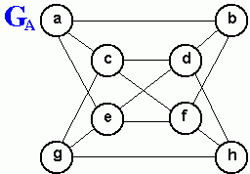
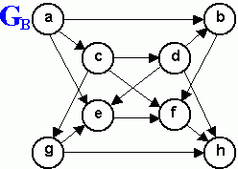
Review Questions
Consider a depth-first traversal of the undirected graph GA shown above, starting from vertex a.
  List the order in which the nodes are visited in a preorder traversal showing the depth-first traversal tree.
  List the order in which the nodes are visited in a postorder traversal
Repeat exercise 1 above for a depth-first traversal starting from vertex d.
List the order in which the nodes of the undirected graph GA shown above are visited by a breadth first traversal that starts from vertex a, showing the breadth-first traversal tree. Repeat this exercise for a breadth-first traversal starting from vertex d.

